Slide 1


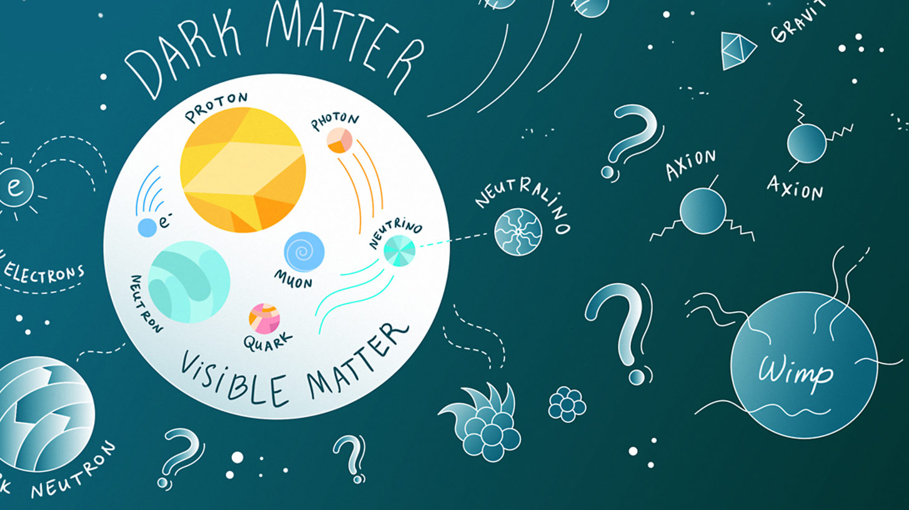
What are dark stars?

Slide 2

What is matter ?
For a layman, matter is "we and everything around us".
When someone ask a physicist that what does mean by the word "matter", the reply comes, some entity that contain "mass" and occupy volume and which interact with fields and potentials.

Slide 3
How matter became dark?
A crude way to understand is, when matter not respond to certain sensations that we normally perceive.
Understanding the in-depth, why and how matter get its prefix as "dark" giving rise to "dark matter" require that we understand the birth and growth of physics that too "cosmology, astrophysics and particle physics" from its early stages of Copernicus helio centric model to the fundamental understanding of formation of universe itself.

Slide 4
speculations on nature of matter

Slide 5
Early speculations
Epicurus (341 BCE–270 BCE) further suggested in his “Letter to Herodotus” that an infinite number of other worlds existed as well, “some like this world, others unlike it.”
the Pythagorean Philolaus conjectured the existence of the celestial body Antichthon, or counter-earth, which revolves on the opposite side of the “central fire” with respect to the Earth.
By pointing his telescope toward the sky, Galileo saw much that had been previously imperceptible. Among his many other discoveries, he learned that the faint glow of the Milky Way is produced by a myriad of individual stars, and that at least four satellites, invisible to the naked eye, are in orbit around Jupiter.
Notes:
First, the Universe may contain matter that cannot be perceived by ordinary means. And second, the introduction of new technology can reveal to us forms of matter that had previously been invisible.

Slide 6
Initial dark objects and regions
First, the Universe may contain matter that cannot be perceived by ordinary means. And second, the introduction of new technology can reveal to us forms of matter that had previously been invisible.
In a letter published in 1844 (Bessel, 1844), he argued that the observed proper motion of the stars Sirius and Procyon could be explained only by the presence of faint companion stars, influencing the observed stars through their gravitational pull.
French astronomer Urbain Le Verrier and the English astronomer John Couch Adams, in order to explain some persistent anomalies in the motion of Uranus, proposed the existence of a new planet.
Notes:
French astronomer Urbain Le Verrier and the English astronomer John Couch Adams, in order to explain some persistent anomalies in the motion of Uranus, proposed the existence of a new planet.

Slide 7
What is wimp?

Slide 8
WIMP theorized particles
By the end of the 1980s, the conclusion that most of the mass in the Universe consists of cold and non-baryonic particles had become widely accepted.
In addition to massive neutrinos (sterile or otherwise), supersymmetric particles (neutralinos, gravitinos, sneutrinos, axions) and axions were each widely discussed as prospective dark matter candidates.
The predicted thermal relic abundance of such a species to match the observed dark matter density, the dark matter particles must self-annihilate with a cross section on the order of σv ∼ 10^(−26) cm3/s (where v is the relative velocity between the annihilating particles).
Furthermore, such conclusions are not limited to neutrinos, but apply to a broad range of electroweak-scale dark matter candidates—including any number of stable particles with MeV–TeV masses and interactions that are mediated by the exchange of electroweak-scale particles.
Notes:
French astronomer Urbain Le Verrier and the English astronomer John Couch Adams, in order to explain some persistent anomalies in the motion of Uranus, proposed the existence of a new planet.

Slide 9
Wimp annihilates
Many WIMP candidates are their own antiparticles, and if they are initially in thermal equilibrium in the early Universe, they annihilate with one another so that a predictable number of them remain today.
In particular, annihilations taking place within high-density dark matter halos, such as that of the Milky Way, could plausibly produce a flux of gamma rays that was not much fainter than that observed at high galactic latitudes and with a distinctive gradient on the sky (Gunn et al., 1978; Stecker, 1978).
Notes:
French astronomer Urbain Le Verrier and the English astronomer John Couch Adams, in order to explain some persistent anomalies in the motion of Uranus, proposed the existence of a new planet.

Slide 10
Normal source vs Dark source of stars
It is now known that the initial stages of a star is powered by Nuclear Fusion of Hydrogen nuclei with itself to generate Helium nuclei, going the called pp chain.
While it is proposed that the dark source of stars is the heat from the dark matter annihiliations. The predicted thermal relic abundance of such a species to match the observed dark matter density, the dark matter particles must self-annihilate with a cross section on the order of σv ∼ 10−26 cm3/s (where v is the relative velocity between the annihilating particles).
Notes:
French astronomer Urbain Le Verrier and the English astronomer John Couch Adams, in order to explain some persistent anomalies in the motion of Uranus, proposed the existence of a new planet.

Slide 11
Proposed birth of early stars
Once dark matter halos about a million times as massive as the Sun ( 10^6 M0 ), known as ‘minihalos’ 9 , were able to form, the conditions were ripe for the formation of the first stars, known as Population III stars.
The virial temperatures of minihalos led to molecular hydrogen cooling that allowed a protostellar cloud to start to collapse towards the center of the halo.
The annihilation products of the dark matter inside the star can be trapped and deposit enough energy to heat the proto-star and prevent it from further collapse. A new stellar phase results, a ‘dark star’, powered by DM annihilation as long as there is DM fuel, for possibly millions to billions of years.
Notes:
French astronomer Urbain Le Verrier and the English astronomer John Couch Adams, in order to explain some persistent anomalies in the motion of Uranus, proposed the existence of a new planet.

Slide 12
Formation of dark stars (proto star)
Spolyar et al [12] outlined the three key ingredients for DSs:
High dark matter densities.
The annihilation products become trapped inside the star.
DM heating wins over other cooling or heating mechanisms.
Notes:
French astronomer Urbain Le Verrier and the English astronomer John Couch Adams, in order to explain some persistent anomalies in the motion of Uranus, proposed the existence of a new planet.

Slide 13
DM density and annihilation
The DM annihilation rate goes as . Thus as the rate is proportional to density squared, high density favors the DM annihilation rate.
The annihilation products and their energy spectrum depend on the WIMP model: for neutralino DM, the annihilation products typically are 1/3 neutrinos, 1/3 photons and 1/3 charged stable particles (electrons and positrons).
Notes:
French astronomer Urbain Le Verrier and the English astronomer John Couch Adams, in order to explain some persistent anomalies in the motion of Uranus, proposed the existence of a new planet.

Slide 14
Annihilations and energy
While neutrinos escape from the cloud without depositing an appreciable amount of energy, the rest can transmit energy to the core. Thus, around 2/3 of the annihilation energy is then trapped inside the collapsing gas, thermalizes with it, and provides a heat source for the resulting dark star.
The trapping of the energy inside the star is dependent on the density of Hydrogen. If the density of Hydrogen is high, the annihilation energy is trapped in the core of DS for further DM annihilation.
Notes:
French astronomer Urbain Le Verrier and the English astronomer John Couch Adams, in order to explain some persistent anomalies in the motion of Uranus, proposed the existence of a new planet.

Slide 15
Cooling of dark star and sustainability
DM heating is the dominant heating/cooling mechanism in the star. We find that, for a WIMP mass of m χ = 100 GeV (1 GeV), a crucial transition takes place when the gas density reaches n > 10 13 cm − 3 ( n > 10 9 cm − 3 ). Above this density, DM heating dominates over all relevant cooling mechanisms, the most important being H2 cooling.
The size of the core at this point is ∼ 17 AU and its mass ∼ 0.6 solar masses for 100 GeV mass WIMPs.
The stability is reached as it is reached in a normal star, but the source is different. Eventually, above a certain baryonic density threshold, which depends on the WIMP mass, the annihilation products that remain trapped in the star thermalize and provide a heat source for hydrostatic and thermal equilibrium: a new type of object is created, a DS supported by DM annihilation rather than fusion.
Notes:
French astronomer Urbain Le Verrier and the English astronomer John Couch Adams, in order to explain some persistent anomalies in the motion of Uranus, proposed the existence of a new planet.

Slide 16
The growth of dark stars
Unlike normal stars, Dark stars are born with masses ∼ 1 M and then grow to much larger masses. They are giant, puffy (10 AU), and cool (surface temperatures∼10 000 K) objects.
Since the DSs reside in a large reservoir of baryons (15% of the total halo mass), the baryons can start to accrete onto the DSs.
Once a dark star is born, with an initial mass∼1M , it accretes mass from the surrounding medium and grows as long as the dark matter fuel persists.
Notes:
French astronomer Urbain Le Verrier and the English astronomer John Couch Adams, in order to explain some persistent anomalies in the motion of Uranus, proposed the existence of a new planet.

Slide 17
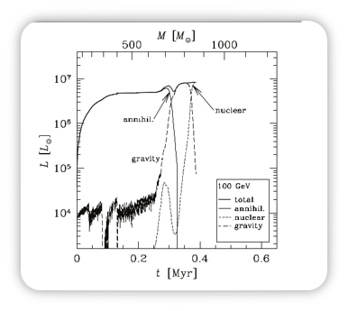
The different cycles of DS
There are four contributions to the total luminosity of the Dark Stars. The total luminosity
The first source, heating due to DM annihilation in the course of adiabatic contraction, dominates from the time of DS formation until the DM runs out.
Once the DM fuel runs out, the star contracts in order to maintain pressure support, and the DS phase is over. The contrib­ution of Lgrav due to gravitational energy release briefly powers the star.
Only as the star starts to collapse (en route towards the fusion-powered main sequence), do the stellar densities become large enough to efficiently capture DM.
Notes:
French astronomer Urbain Le Verrier and the English astronomer John Couch Adams, in order to explain some persistent anomalies in the motion of Uranus, proposed the existence of a new planet.

Slide 18
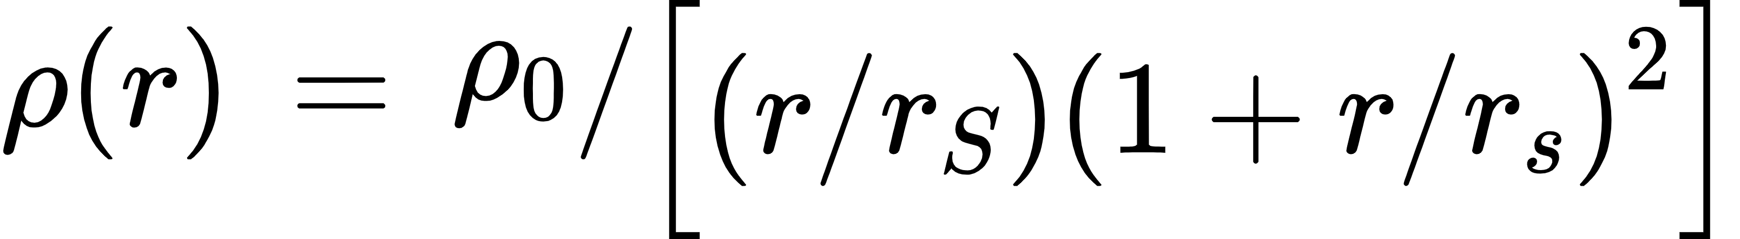
Halo mass and ds refulleing
The first stars form inside ∼ 10^6 solar masses halos. One of the the density profile that is used for density distributioin is the NFW or Navarro, Frenk, & White profile which gives the density variation as
As the baryons start to collapse into a protostellar cloud at the center of the DM halo, the DM responds to the changing gravitational potential well. Adiabiatic contraction, AC, can be used to describe the increase in the dark matter density.
DM reservoir inside the DS can be refueled by DM capture, in addition. This requires the scattering of the WIMP from the hydrogen nuclei and lose energy, so to be trapped inside the star, and in the heat from previous annihilations and gravitational energy, again acts as the source for the energy for the star.
Notes:
French astronomer Urbain Le Verrier and the English astronomer John Couch Adams, in order to explain some persistent anomalies in the motion of Uranus, proposed the existence of a new planet.

Slide 19
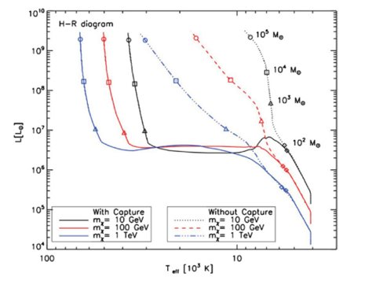
HR Diagram of Ds and comparison with fusion stars.
The HR diagram is constructed using the polytropic interior of the star.
Using Hoyle results and temperatures for DS with Adiabiatic compression, the core temperature of the DS∼10^6, while for fusion star it goes more than 10^8 K. This gives that DS are of larger radii than fusion stars but with lower T surface.
Notes:
French astronomer Urbain Le Verrier and the English astronomer John Couch Adams, in order to explain some persistent anomalies in the motion of Uranus, proposed the existence of a new planet.

Slide 20
Finally, what are dark stars ?
Dark stars are stars made (almost entirely) of hydrogen and helium but powered by dark matter (DM) annihilation, rather than by fusion. They are in hydrostatic and thermal equilibrium, but with an unusual power source.
We have reviewed how they come into existence, how they grow as long as dark matter fuel persists, and their stellar structure and evolution.
It is interesting to speculate that the Initial Mass Function of the first fusion-powered stars may be determined by the details of the dark matter distribution resulting from cosmological structure formation.
Notes:
French astronomer Urbain Le Verrier and the English astronomer John Couch Adams, in order to explain some persistent anomalies in the motion of Uranus, proposed the existence of a new planet.

Slide 21
My references
Katherine Freese et al 2016, Dark stars: a review. DOI: 10.1088/0034-4885/79/6/066902
Hooper D and Bertone G 2018, History of dark matter. DOI: 10.1103/RevModPhys.90.045002
Notes:
French astronomer Urbain Le Verrier and the English astronomer John Couch Adams, in order to explain some persistent anomalies in the motion of Uranus, proposed the existence of a new planet.

